Slide 1

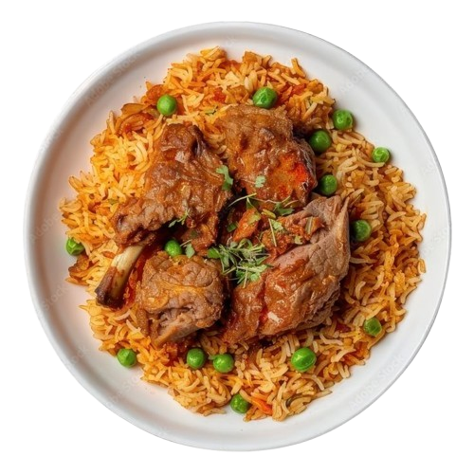
DHAKAIYA BITES
Restaurant Management Website

Slide 2


Agenda
01
Team Members
06
Backend Logic
02
Project Overview
07
UI/UX
Workflow Demo
Challenges
03
08
Future Enhancements
04
System Architecture
09
Database
10
Skill Development
05
11
Conclusion

Slide 3
Team Members
Clement Raka De Costa (ID: 2233081243)
Fariha Hasanat (ID: 2233081250)
Backend Developer, Database Administrator
Documentation Director, Database Administrator
Md. Mustafizur Rahman
(ID: 2233081453)
Md. Maharab Shuvo (ID: 2233081278)
Fronted Lead Developer
Documentation Specialist
Afroza Hossain Sorno (ID: 2233081249)
Debottom Chakma (ID: 2233081529)
Fronted Developer, Documentation Advisor
Content Coordinator

Slide 4




Project Overview
01
02
Traditional Restaurant Website
User-Friendly Interface
Presents classic dishes in a modern digital style
Easy menu browsing with smooth navigation.
Visual Menu With Images
03
Easy Menu Management
04
Shows food items with clear photos and details.
Admin can update items quickly and easily.

Slide 5





Workflow Demo
Choose & Processed
Post-Service
Interaction
Step
01
Step
02
Step
03
Step
04
Welcome &
Navigation
Complete
Transaction

Slide 6







System Architecture
Frontend
Backend
01
02
HTML CSS, JavaScript
Python, Django
System Architecture
Database
03
MySQL

Slide 7





Database
Customers
Menu
Sales Transaction
Reservation
02
04
06
08
01
03
05
07
Employees
Food Orders
Inventory
Accounts

Slide 8
Backend Logic
GET for most tasks; POST for file uploads.
MySQL connector Library
01.
02.
03.
04.
05.
Django with direct MySQL (no ORM).
Custom SQL CRUD operations
Minimal error handling; steep learning curve.

Slide 9
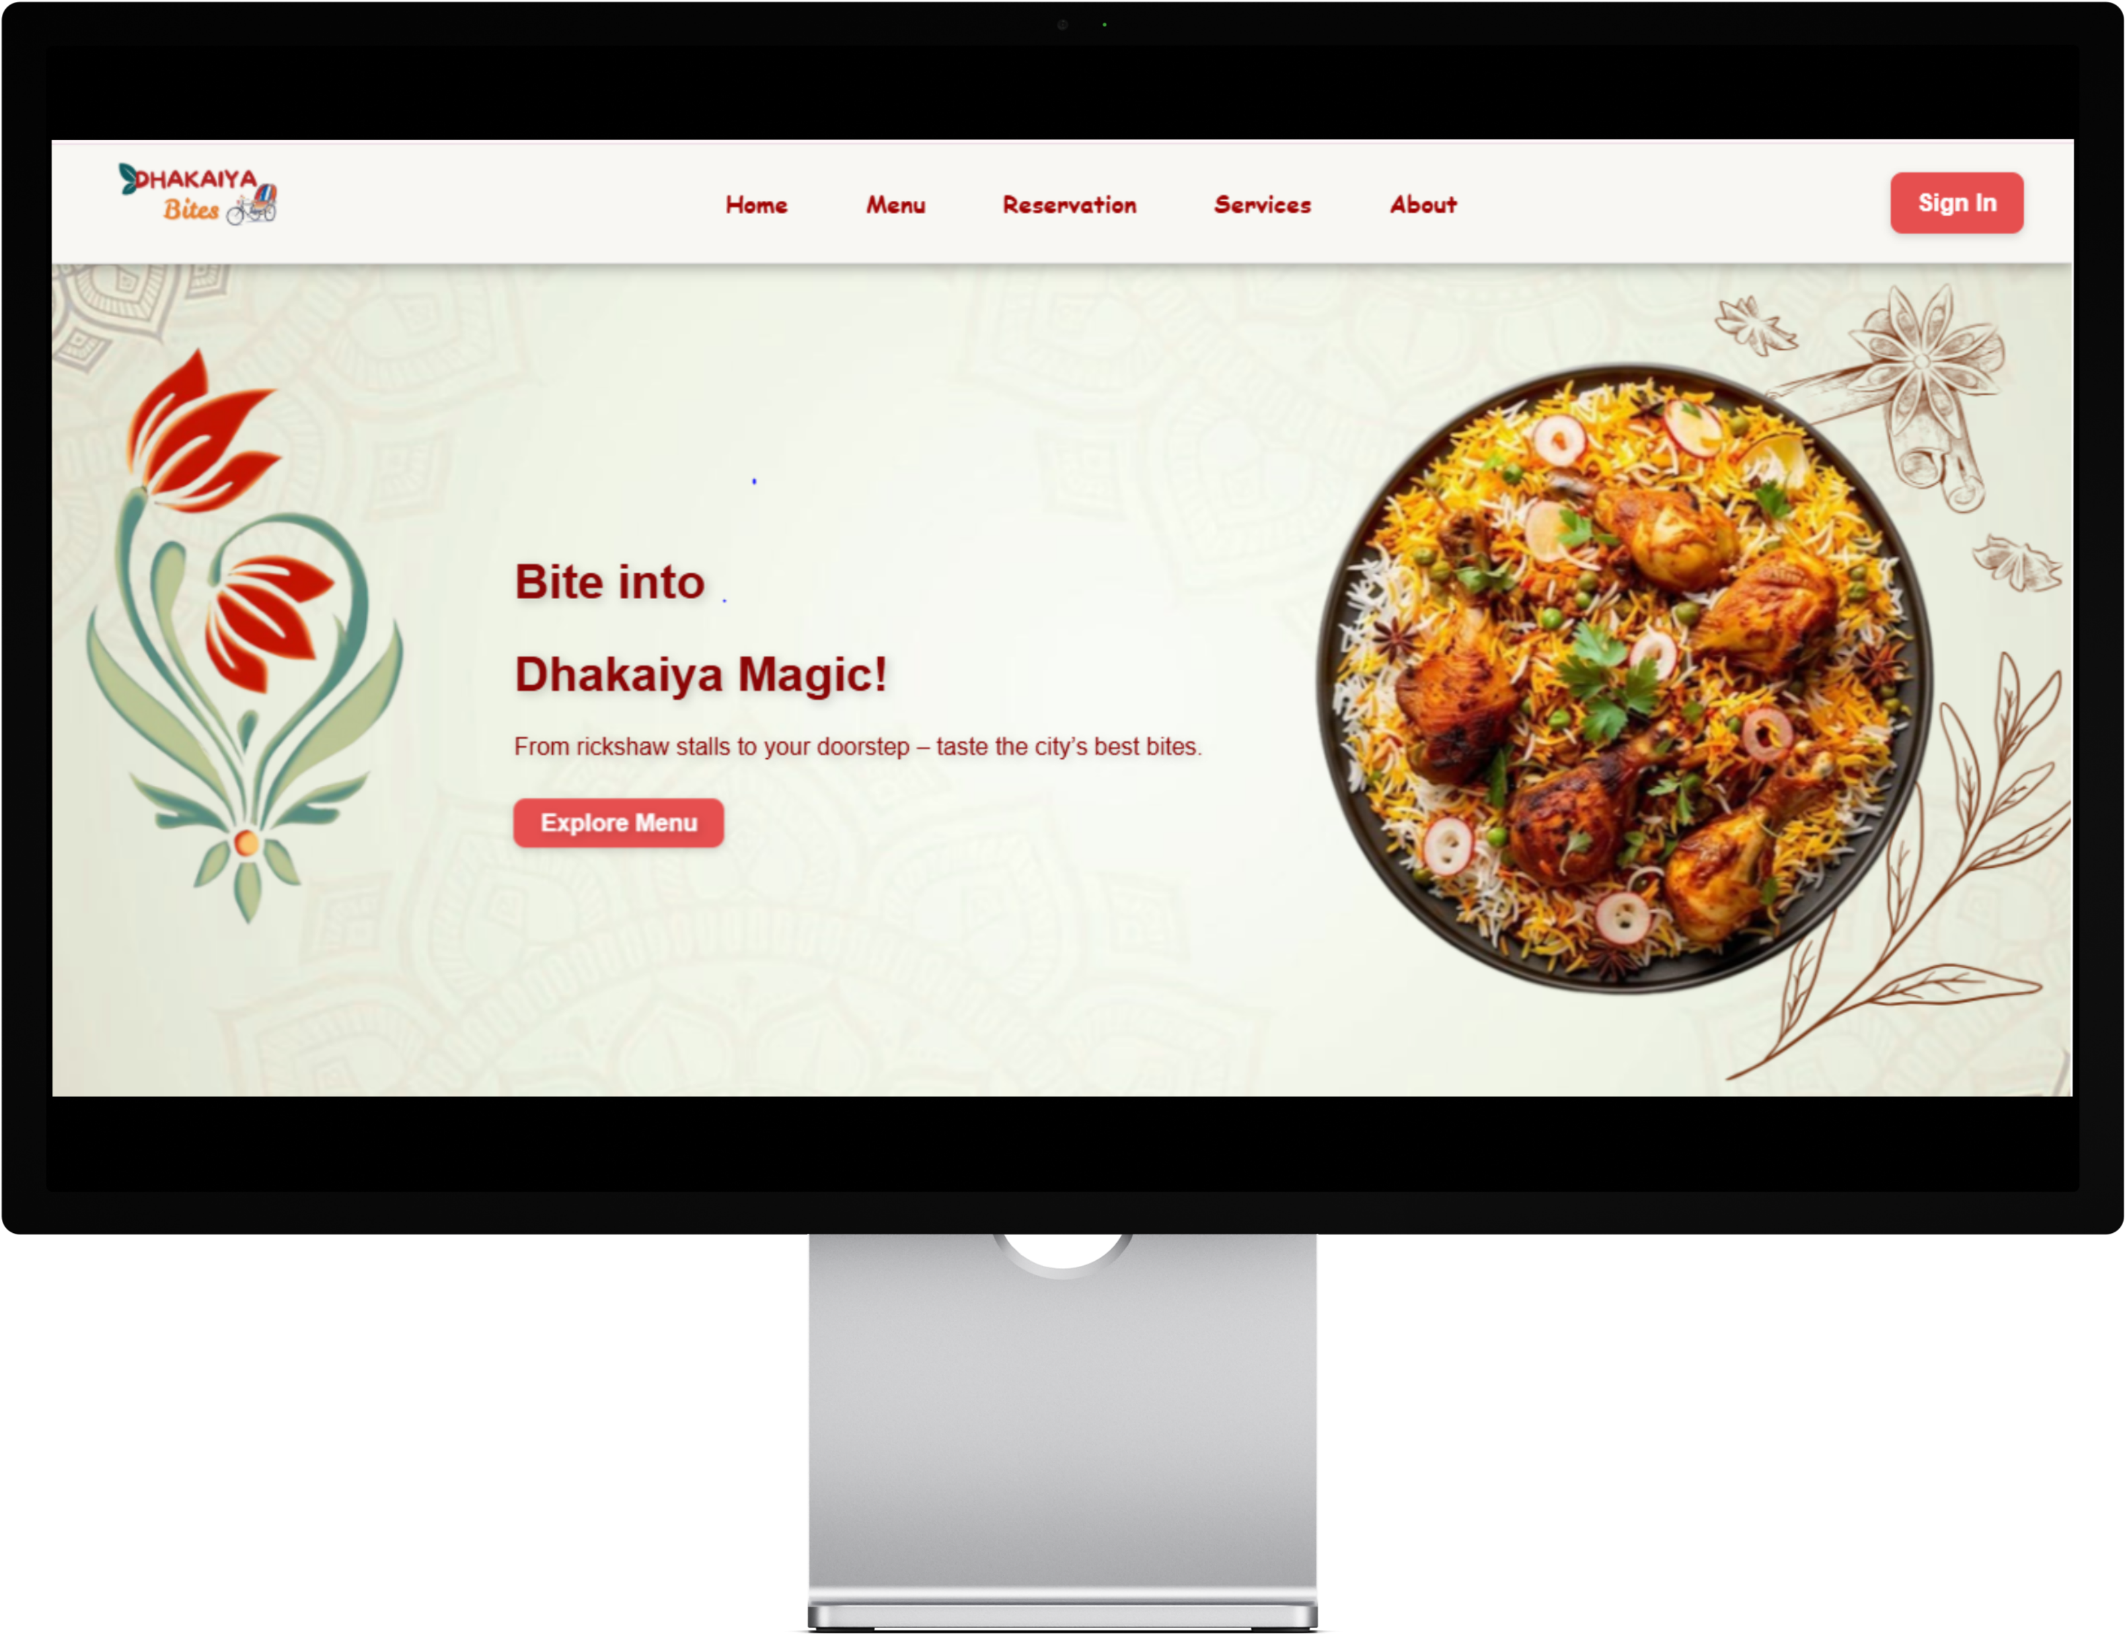
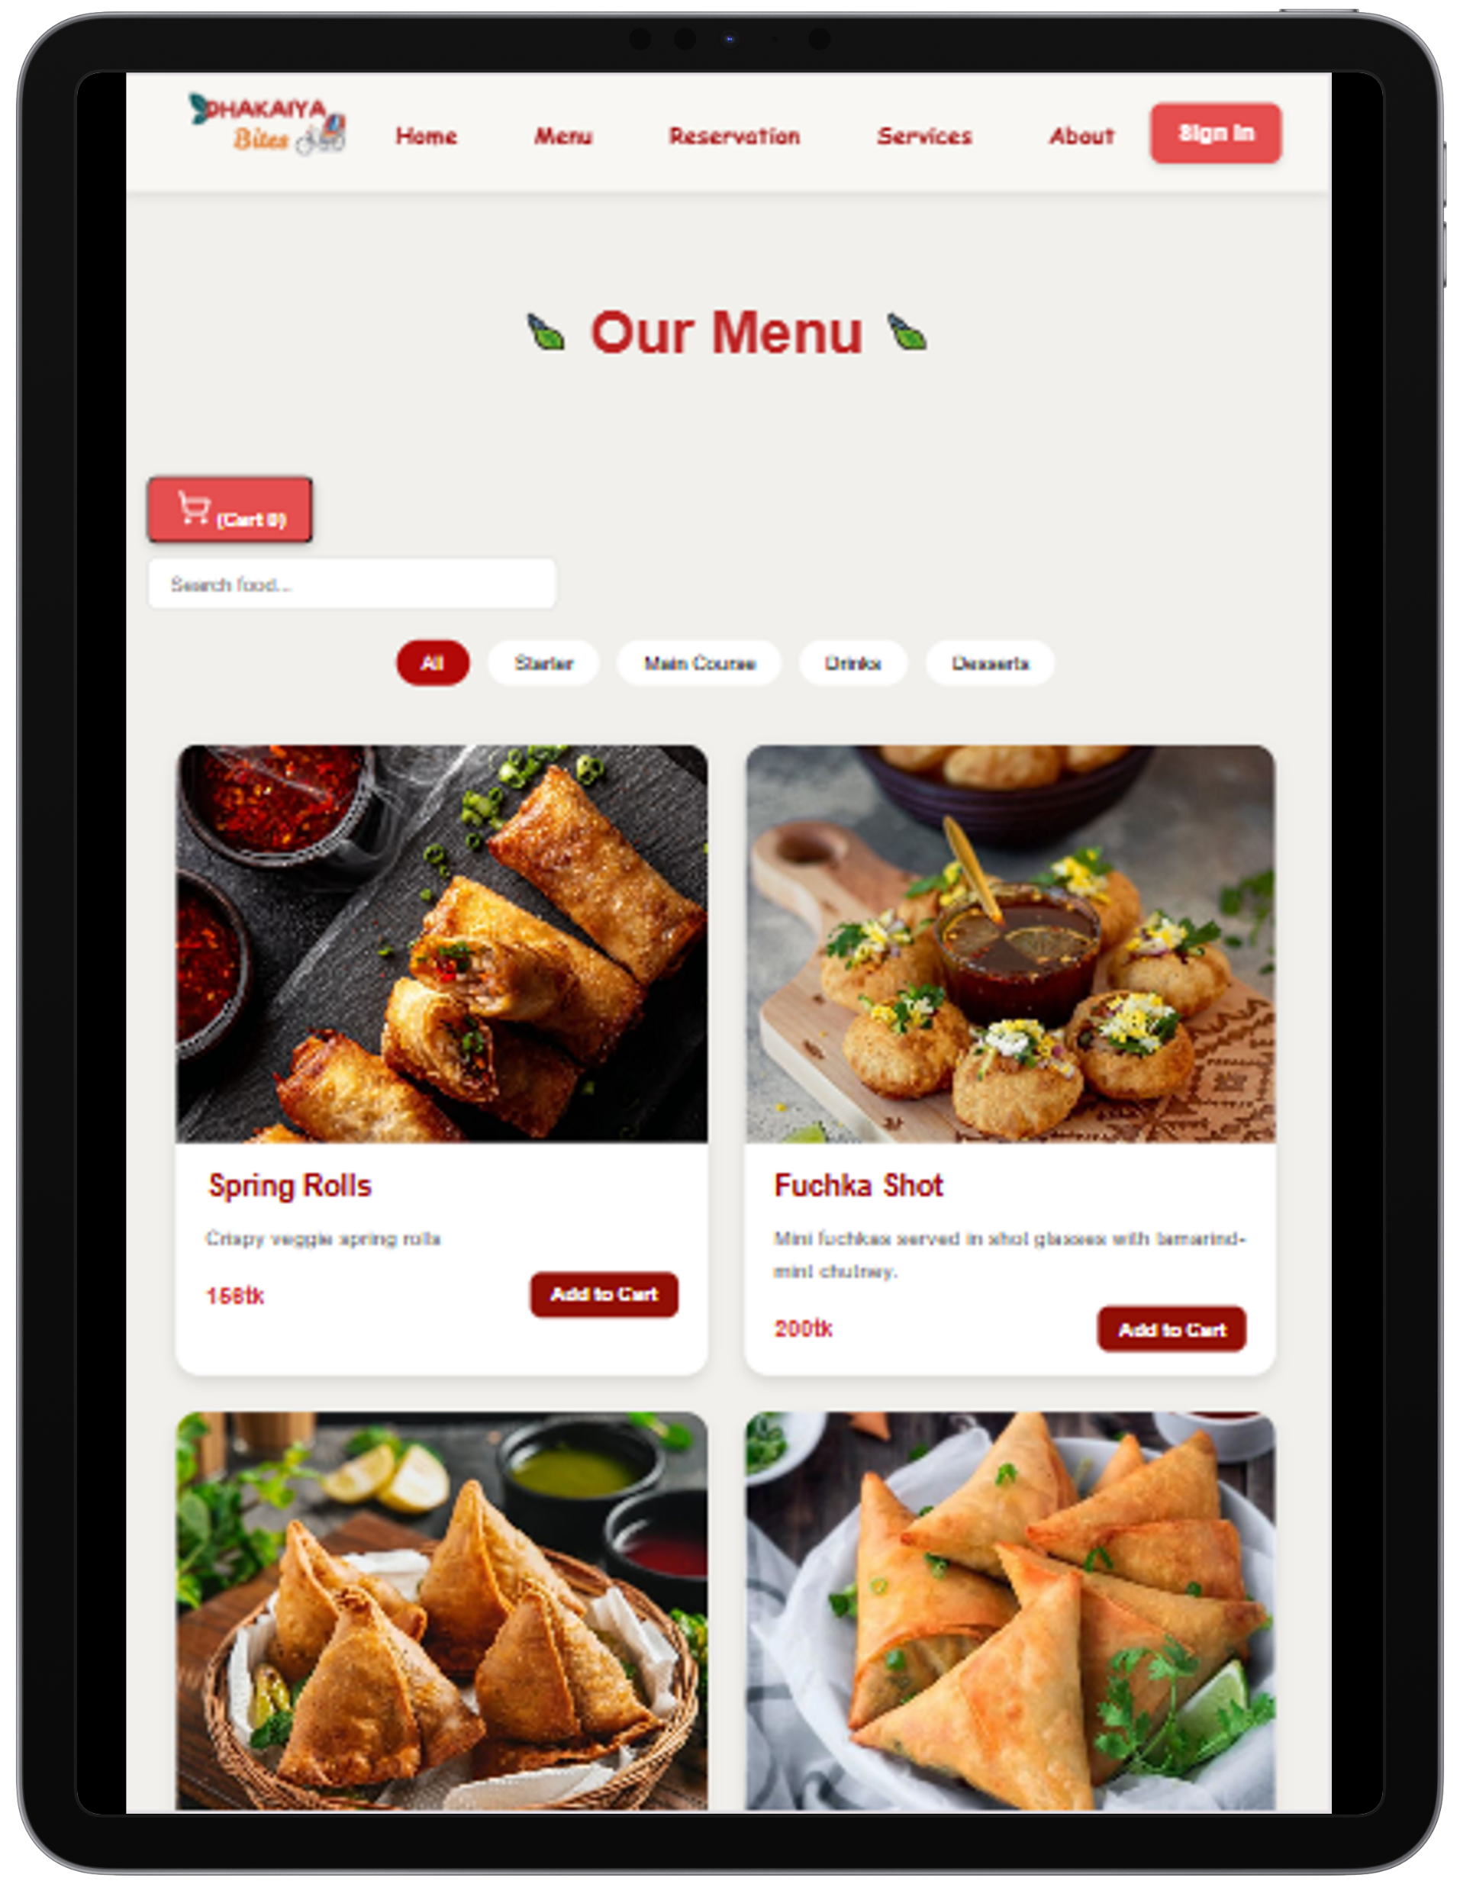
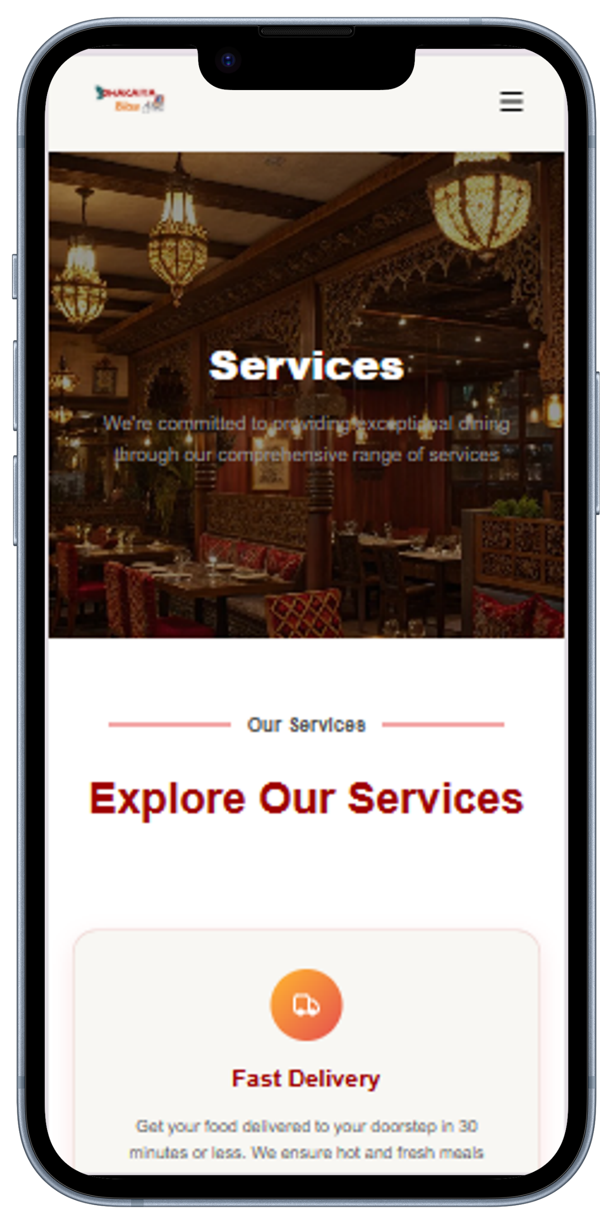
UI /UX
Ui research & Wireframing
01
Navigation structure & responsive design
02
Competitor research
03
Frontend backend compatibility
04

Slide 10

Challenges
1
4
NO CUSTOMER FEEDBACK OR REVIEW SYSTEM
Poor search engine ranking (SEO issues)
2
5
NO SOCIAL MEDIA INTEGRATION
Security issues
3
6
LIMITED PAYMENT OPTIONS
Time Constraints & Skill Limitations

Slide 11
Future Enhancements
Add stronger security
01
05
Enhance inventory automation
.
02
06
Improve UI/UX design
Add online payment system
.
03
07
Improve error handling (try–except)
Use POST for authentication
.
04
08
AI-enhanced fraud detection
Customer Login

Slide 12









Skill Development
02
04
Learned HTML, CSS, JS, Django & MySQL
Built complete full-stack experience
Understood full website flow
AI-assisted learning & debugging
Gained frontend–backend–DB skills
01
03
05

Slide 13
Conclusion
01
Complete functional system built.
04
Teamwork and collaboration achieved.
02
Frontend–backend–database integrated.
05
Overcame technical learning challenges.
.
03
06
Future improvements identified.
Major features implemented.
.

Slide 14

Thank You / Q&A
Credits:
Clement Raka De Costa (ID: 2233081243)
Md. Mustafizur Rahman
(ID: 2233081453)
Afroza Hossain Sorno (ID: 2233081249)
Fariha Hasanat (ID: 2233081250)
Md. Maharab Shuvo (ID: 2233081278)
Debottom Chakma (ID: 2233081529)

